Slide 1
CS3210 Lab 3
GPU Parallel Programming in CUDA
Slides stolen from Zhi Heng
inspired by Sriram's slides
with extra tidbits

Slide 2
Lab 2 Curiosities: 2 billion instructions?

Slide 3
2 billion Instructions?
perf stat -e fp_arith_inst_retired.scalar_single ./mm-seq 1000
Why did we see the number of instructions we saw?

Slide 4
2 billion Instructions?
perf stat -e fp_arith_inst_retired.scalar_single ./mm-seq 1000
Why did we see the number of instructions we saw?
for (i = 0; i < size; i++)
for (j = 0; j < size; j++)
for (k = 0; k < size; k++)
result.element[i][j] += a.element[i][k] * b.element[k][j];

Slide 5
2 billion Instructions?
perf stat -e fp_arith_inst_retired.scalar_single ./mm-seq 1000
Why did we see the number of instructions we saw?
for (i = 0; i < size; i++)
for (j = 0; j < size; j++)
for (k = 0; k < size; k++)
result.element[i][j] += a.element[i][k] * b.element[k][j];
One sum and one mul per result over 1000x1000 result elements (2 billion fp ops). So why are there 2 billion +1 instructions?

Slide 6
2 billion Instructions?
So why are there 2 billion +1 instructions?
fprintf(stderr, "Matrix multiplication took %1.2f seconds\n",
((float)(after - before)) / 1000000000);
Perf is reliable and consistent*!! :)
*provided that perf does not subsample and your program does not have indeterministic branching

Slide 7
Assignment 1 Shenanigans

Slide 8
A1: How was it? :D
Most submissions are in – if you haven't submitted, keep going at it
Late penalty lenient; the point is to learn
Please format quiz answers correctly ☹

Slide 9
The Burj Khalifa view of CS3210
Part 1: OpenMP
Making single-node CPU programs faster
Complex tasks that are relatively less parallelizable (10s of tasks)
Part 2: CUDA
Making single-node GPU-able programs faster
Simpler tasks that are relatively more parallelizable (millions of tasks even)
Part 3: MPI
Making multi-node programs faster
Large, mixed workloads (slow communication between nodes is worth it due to size / parallelizabilty of work)
You are here!

Slide 10
CUDA is a very deep topic.
We will mainly try to cover the basics - enough!
Highly recommend the CUDA Programming Guide:
https://docs.nvidia.com/cuda/cuda-c-programming-guide/index.html

Slide 11
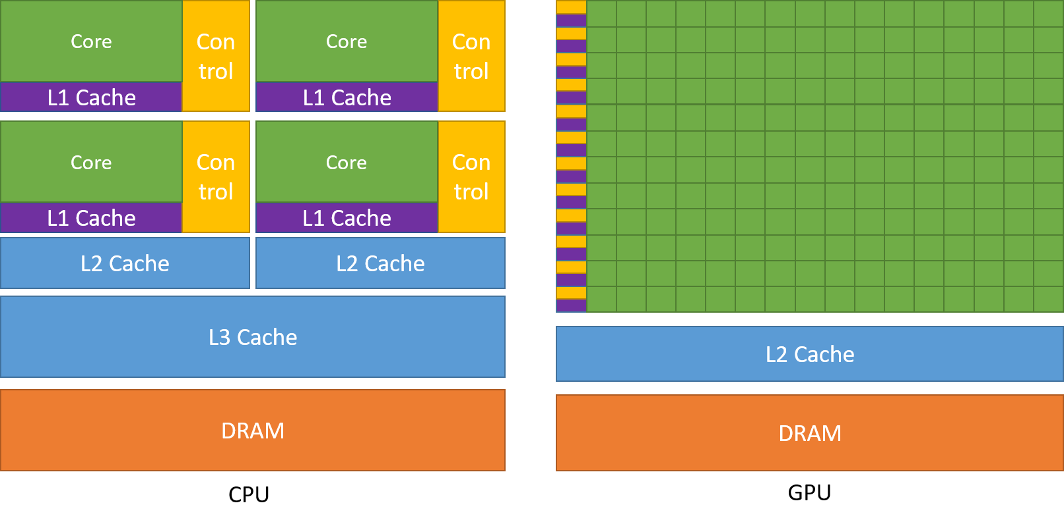
CPU vs GPU: Latency vs Throughput
Complex cores Low latency
Many simple cores High throughput

Slide 12


CPU vs GPU:
CPU
GPU

Slide 13
Main Point:
To maximize CUDA performance, you must understand GPU hardware

Slide 14
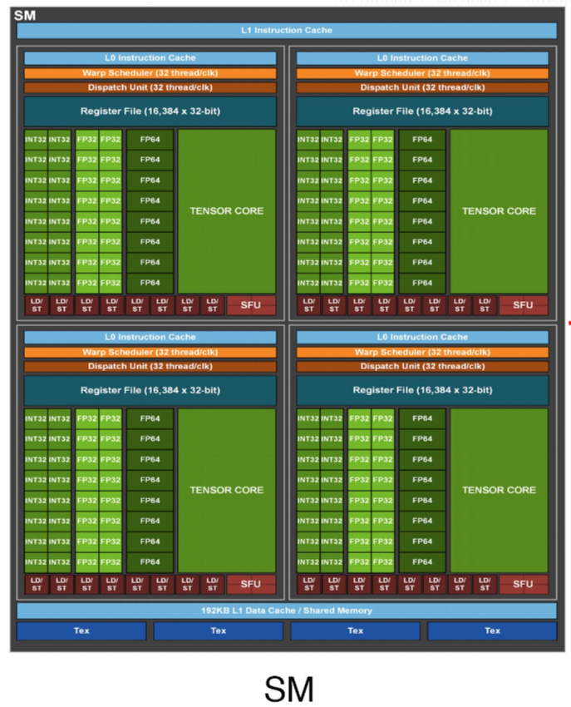
CUDA Physical Structure
GPU: contains many Streaming Multiprocessors (SMs)
Each SM: runs one "thread block" (which contains many threads)
Each SM: runs many warps (groups of 32 threads) in parallel

Slide 15
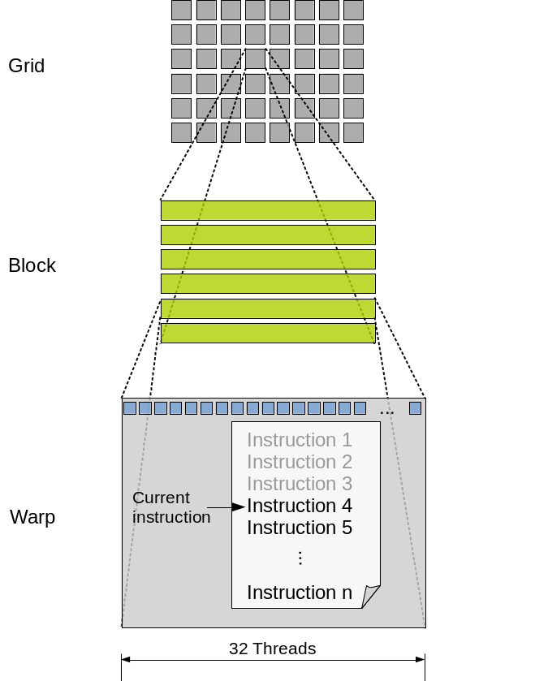
CUDA Logical Hierarchy
A thread executes code on a CUDA core
Specifically, groups of 32 threads (a warp) execute in lockstep in a core.
Threads can be organized in blocks
up to 1024 threads per block (CC ≥ 2)
One block per SM
Blocks are organized into a logical grid
Hardware does not care about grids!

Slide 16
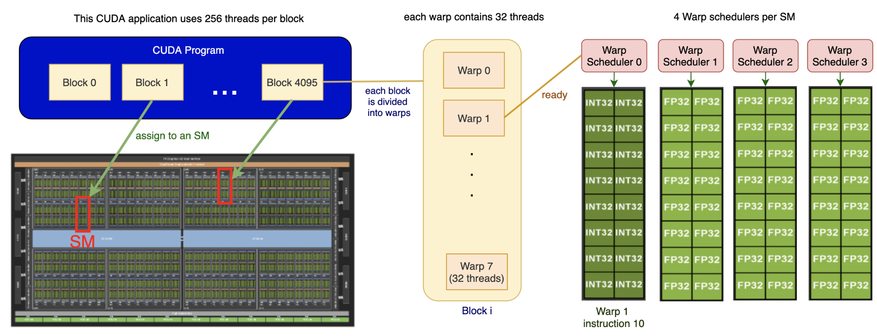
Overview of Physical-Logical Connection

Slide 17
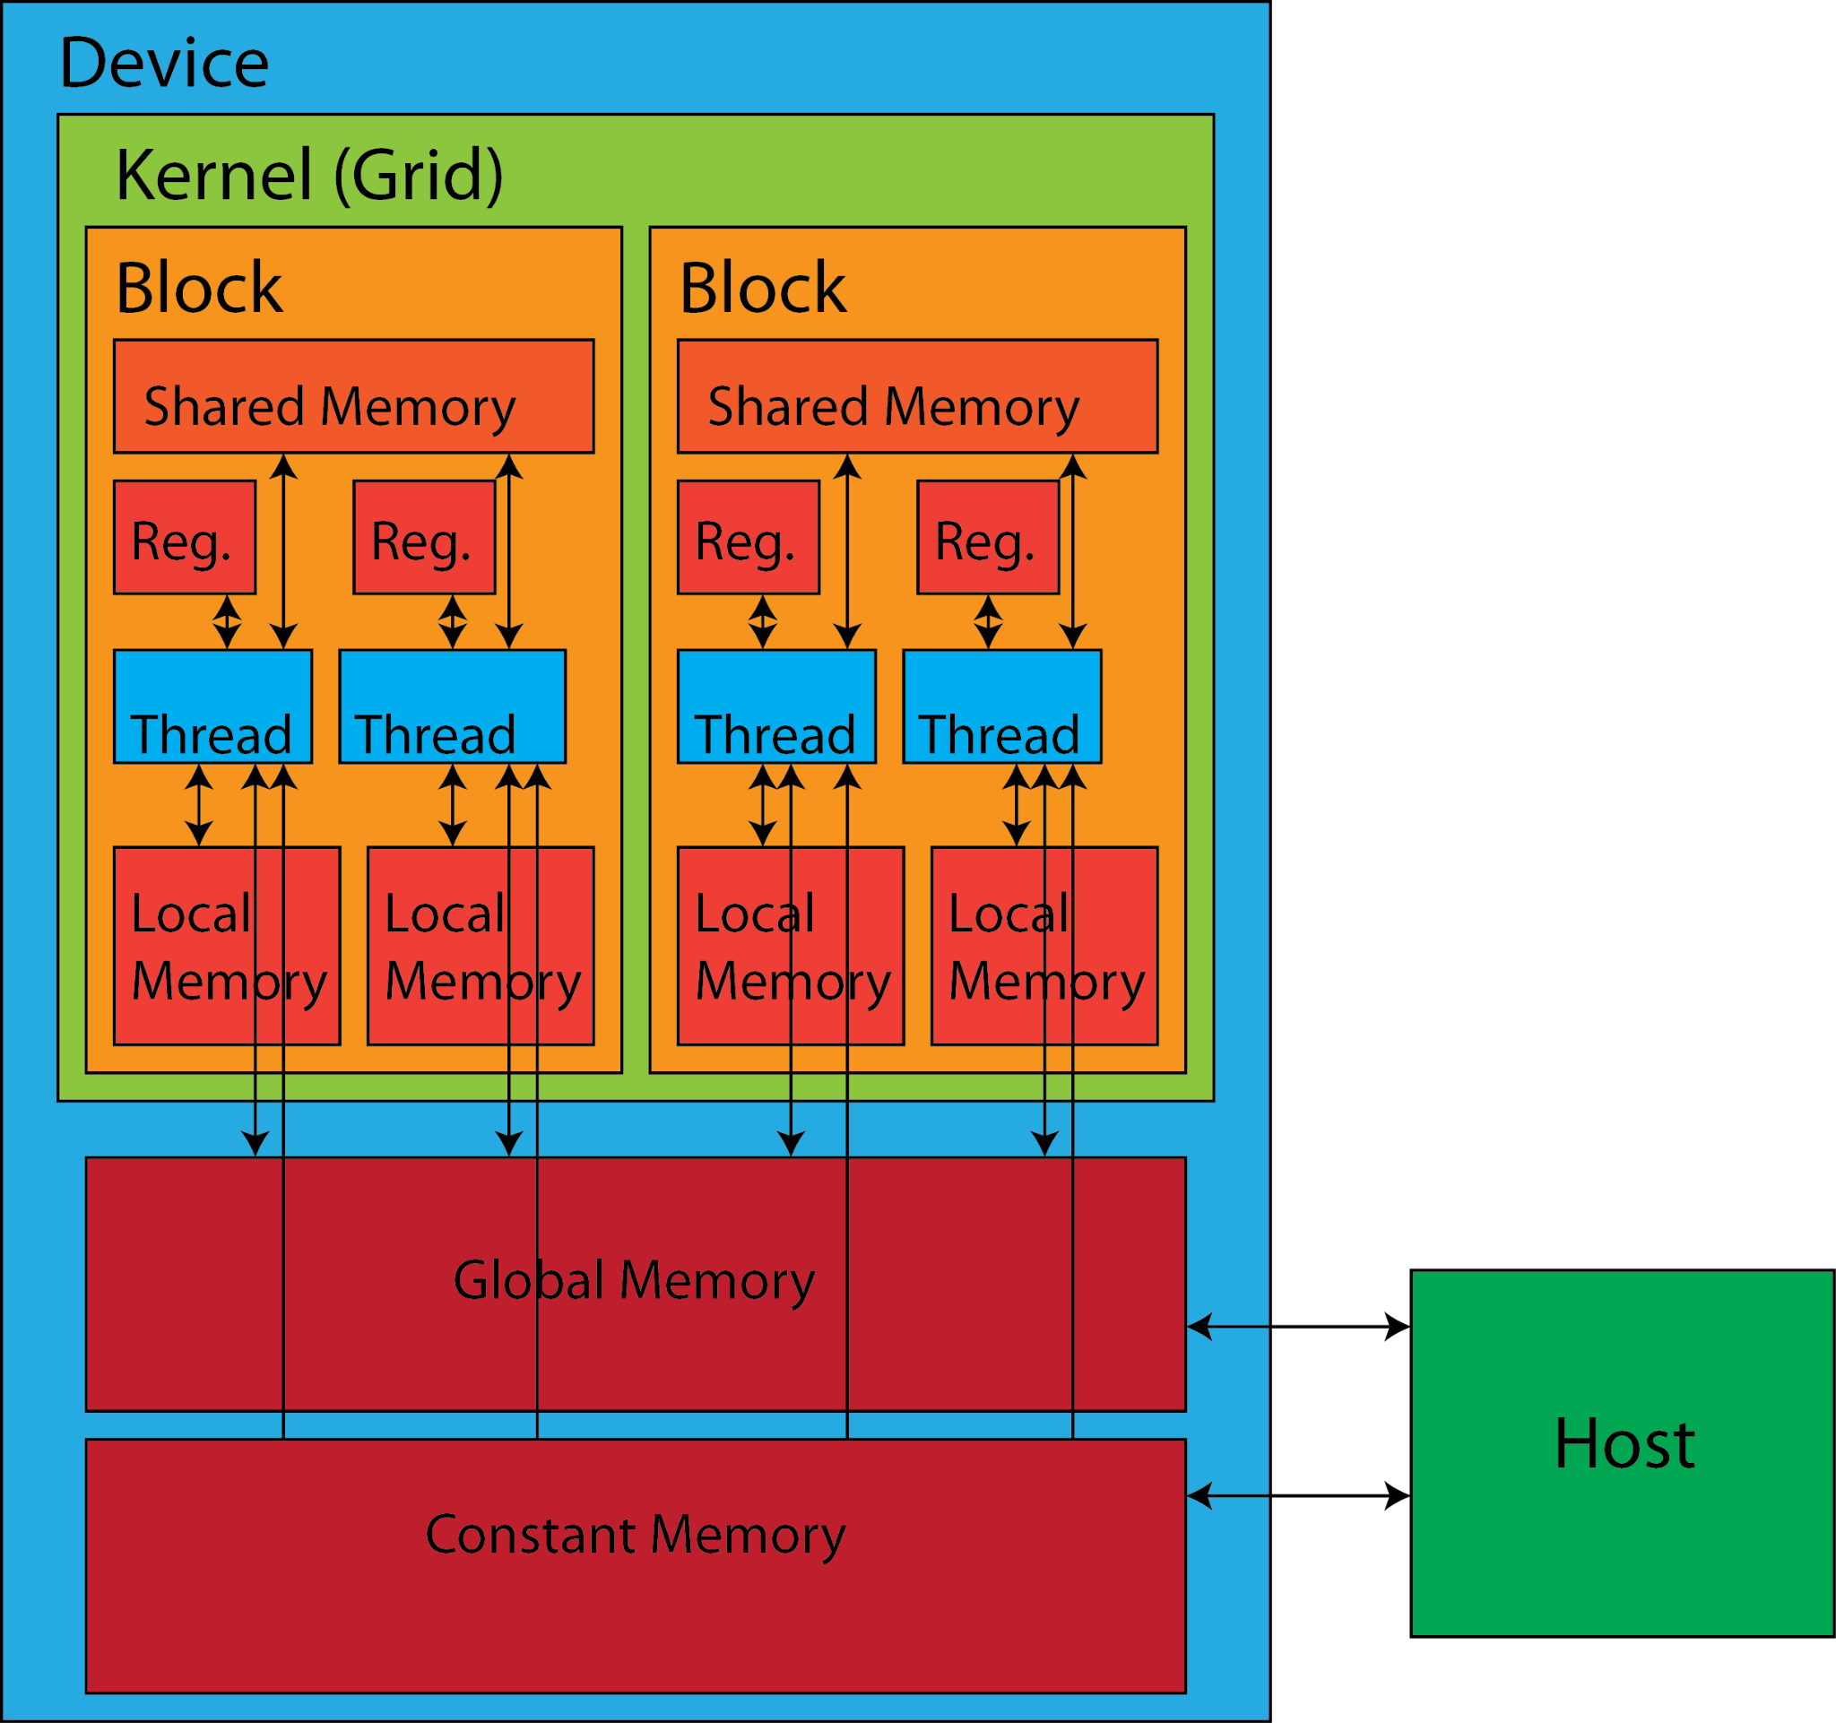
Example optimizations from knowing hardware
Warps are 32 threads, so any block sizes not divisible by 32 have wasted threads (i.e. they run but do no meaningful work)
Keep threads simple and minimize control flow logic (if/else)
Prefer registers > shared > local = global memory

Slide 18
Local Memory
Contrary to the diagram & naming, local memory is actually stored in the same physical location as global memory!
More accurate to call it "thread-local global memory"
Reference: https://docs.nvidia.com/cuda/cuda-c-programming-guide/index.html#device-memory-accesses
Same physical location!
Notes:
Local memory is only be used if there are too many local variables declared in your device code & SM's registers cannot fit all of them.

Slide 19
Today's Lab

Slide 20
Good news!
No submission! 😊
But you should still go through it at least once, for assignment 2!

Slide 21

SoC Cluster vs PDC Cluster
xlogin node
xgp GPU nodes
pdc lab
managed by us
SoC Compute Cluster
managed by SoC
They are on separate networks!

Slide 22
Good news!
We have top-tier GPUs for you to play with!
Node Name | Slurm GPU Name | NVIDIA GPU Name | Compute Capability | Memory | Notes
xgpc[0-9] | nv | Tesla V100 | 7.0 | 16GB
xgpd[0-9] | nv | Titan V | 7.0 | 12GB
xgpe[0-11] | nv | Titan RTX | 7.5 | 24GB
xgpf[0-10] | nv | Tesla T4 | 7.5 | 16GB
xgpg[0-9] | a100-40 | A100 40GB | 8.0 | 40GB
xgph[0-9] | a100-80 | A100 80GB | 8.0 | 80GB
xgph[10-19] | a100-40 | A100 80GB | 8.0 | 40GB | Split into 2x 40GB instances
xgpi[0-9] | h100-96 | H100 96GB | 9.0 | 96GB | 2x H100 96GB
xgpi[10-19] | h100-47 | H100 96GB | 9.0 | 47GB | 2x H100 96GB, split into 4x 47GB instances

Slide 23
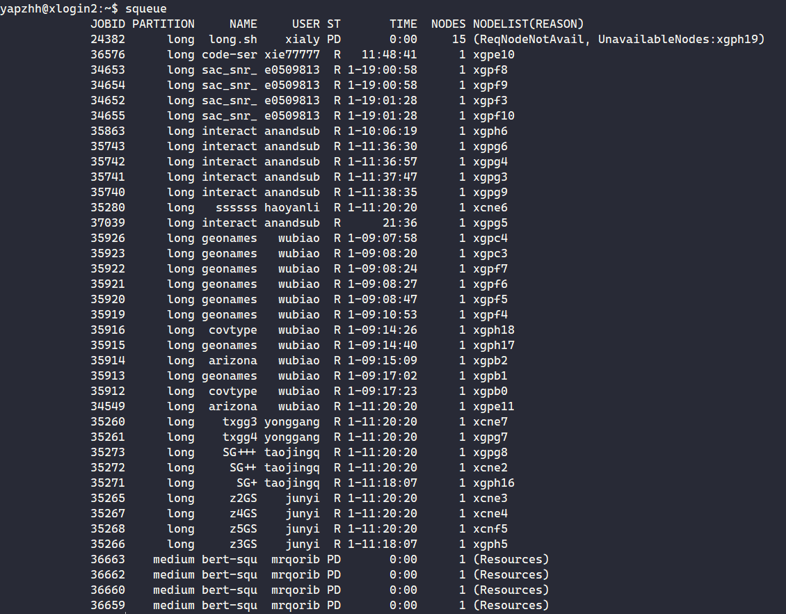
Bad news :(
We have to share with others.
(Currently the cluster is under-utilized, so do let us know if your jobs are not running!)

Slide 24
Login instructions (TLDR)
Ensure you're on FortiClient VPN if you're outside SoC
Can try non-SoC NUS network but I doubt it would work
ssh <SoC unix username>@xlogin.comp.nus.edu.sg
Test that you can get a GPU via srun --gpus=1 bash -c "hostname; nvidia-smi"

Slide 25
Note about CUDA executables
CUDA commands (e.g. nvcc, nsys) is not in $PATH
Cannot just use srun without specifying the full path to the executables i.e. need to specify /usr/local/cuda-12.2/bin/nvcc to compile your code with nvcc
Provided gpu_job.sh script helps you get around that, but you can also use srun manually.

Slide 26
Note about CUDA executables
You can also add this to ~/.bashrc
export PATH="/usr/local/cuda/bin/:$PATH" export LD_LIBRARY_PATH="/usr/local/cuda/lib64:$LD_LIBRARY_PATH"
Now you can just call nvcc without full path!

Slide 27
More life-pro tips from me
Add these lines to ~/.bashrc
export PATH="/usr/local/cuda/bin/:$PATH" export LD_LIBRARY_PATH="/usr/local/cuda/lib64:$LD_LIBRARY_PATH" alias tv100="srun --gpus=1 --constraint=xgpc" alias tvolta="srun --gpus=1 --constraint=xgpd" alias trtx="srun --gpus=1 --constraint=xgpe" alias tt4="srun --gpus=1 --constraint=xgpf" alias a100mig="srun --gpus=a100-40 --constraint=xgph" alias a100a="srun --gpus=a100-40 --constraint=xgpg" alias a100b="srun --gpus=a100-80" alias h100mig="srun --gpus=h100-47" alias h100="srun --gpus=h100-96"
Check the labsheet ☺

Slide 28
Lab 3 Overview
ex1-4: orientation with xlogin's slurm
ex5: hello world
ex6: calculating thread id
ex7-8: understanding warps [demo]
ex9: compile time __device__(global) variables
ex10: cudaMalloc-ed __device__(global) variables
ex11: unified memory with __managed__ [demo]
ex12: shared memory with __shared__
ex13: Atomic memory operations (atomicAdd, etc)
ex14: explicit synchronization [demo]
ex15: putting it together to optimize a simple program
CUDA is very new to you, we generally don't expect you to complete everything within 2 hours.

Slide 29
Ex6 hint
https://www.eecs.umich.edu/courses/eecs498-APP/resources/materials/CUDA-Thread-Indexing-Cheatsheet.pdf
(Can be found in your lab sheet)

Slide 30
Ex7: Understanding Warp Divergence & Independent Thread Scheduling

Slide 31
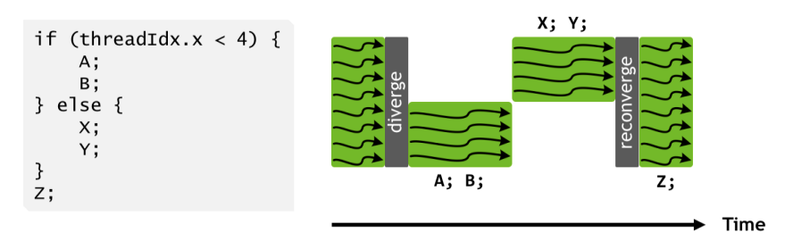
Old: NVIDIA Pascal (<= CC 6.x)
Threads in same warp may diverge under different control flow
Pascal and earlier: entire divergent region must converge first.

Slide 32
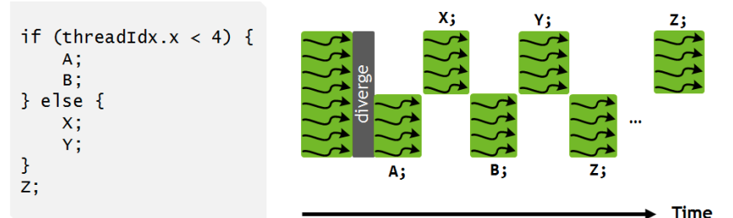
New: NVIDIA Volta (>= CC 7.x)
Independent thread scheduling (ITS)
Different statements in the divergent branches can interleave
New >=CC 7.x
Old <=CC 6.x

Slide 33
Divergent paths
Difference in runtime:
Not much difference in runtime between different CC versions for simple programs!
For more complex programs with many memory operations, the interleaving of control flows will perform slightly better – good to keep in mind when you're optimizing
Control flow divergence within warps can cause slowdowns.
Top reason why some students can't meet our performance criteria for asgn 2 last year.
Minimize the number of if-statements in your device code!
Divergence between warps does not have an issue.
Notes:
source: trust me bro i marked assignment 2 last year

Slide 34
Ex11: Unified Memory

Slide 35
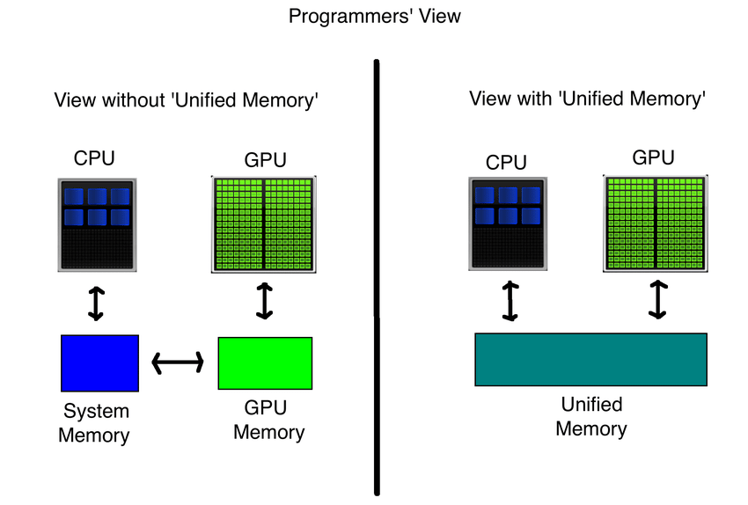
Unified Memory

Slide 36
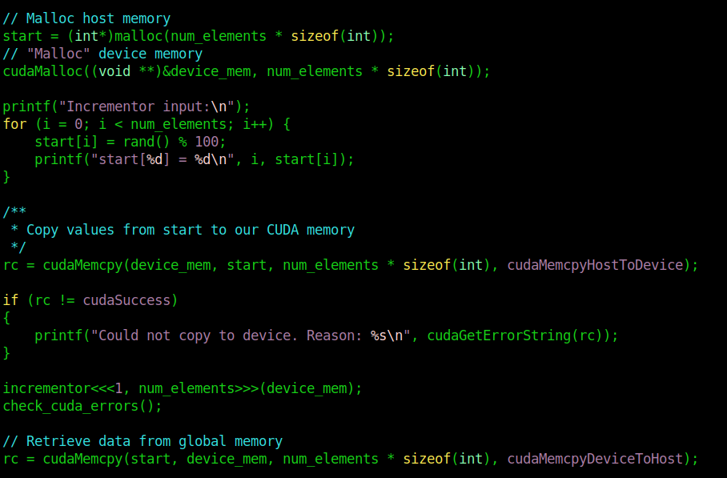
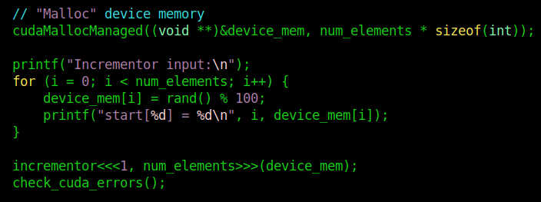
Unified Memory
Normal
Unified

Slide 37
Why not used unified memory always?
Unified is likely slightly slower! But much easier to program.
But code running slower may not always be true! Largely depends on how well you are able to optimize memory operations manually in CUDA.

Slide 38
Performance Profiling

Slide 39
Performance Profiling
The greatest sin of optimization: optimization without profiling
How to profile CUDA applications?
ncu (NVIDIA Compute CLI, for kernels) & nsys (NVIDIA NSight Compute, general profiler)
Read: https://gpuhackshef.readthedocs.io/en/latest/tools/nvidia-profiling-tools.html
Examples
nsys nvprof ./sum
nsys profile -o sum_profile ./sum
Then, nsys analyze sum_profile.nsys-rep
ncu ./sum

Slide 40
End of Lab 3
Anonymous Feedback: https://bit.ly/feedback-theodore
All the best for midterms!

